Slide 1
Big Mountain Pricing Strategy
Vignesh Selvakumaran

Slide 2
AGENDA
Problem Identification
Recommendations and Key Findings
Modeling Results and Analysis
Summary

Slide 3
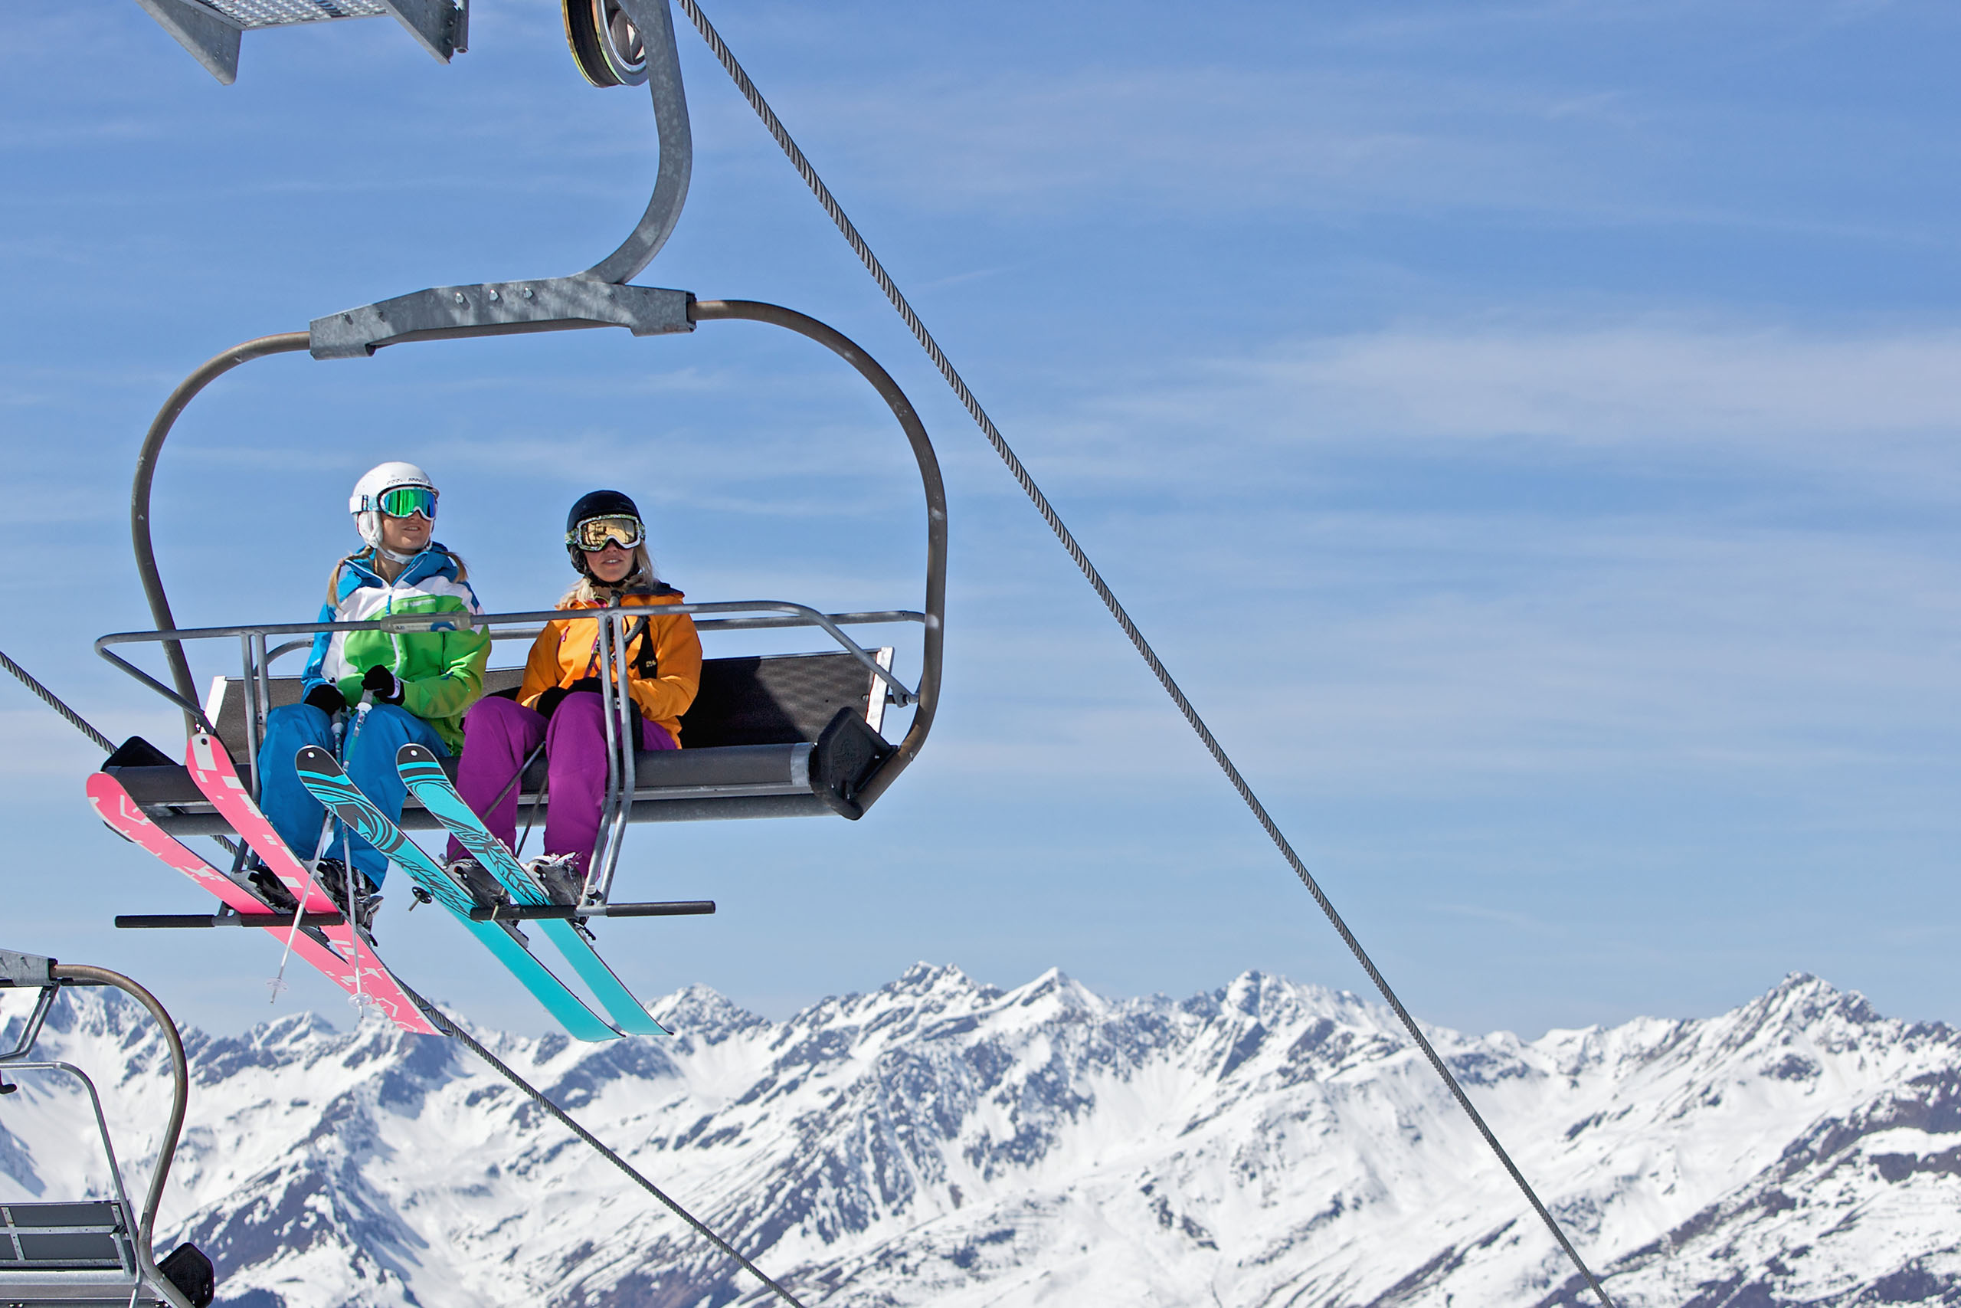
Problem Identification:
Big Mountain recently installed a chair lift to help increase the distribution of visitors across the mountain
Expected operational cost increase of $1,540,000 a year
What pricing strategy can we implement to cover these costs?

Slide 4
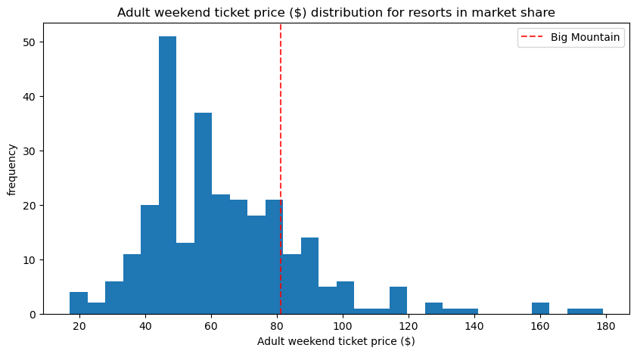
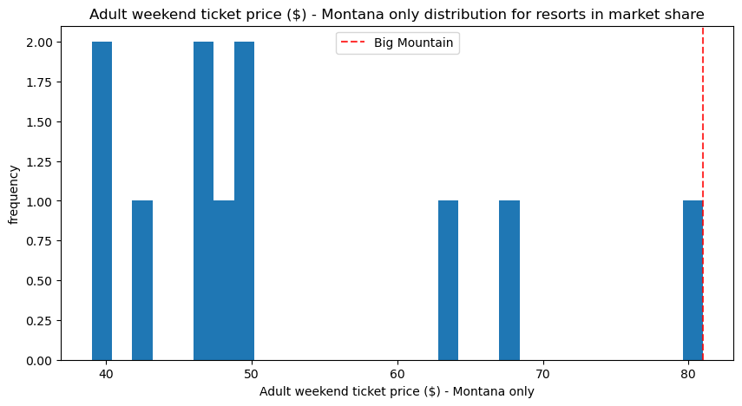
Where we Stand on pricing today?
Our ticket is priced at $81
Within the US, we are above the median of offerings
Within Montana, we are the highest offering
Can we justify a price increase in our current market?
Our pricing strategy needs to increase revenue, but should be a value add for our customers

Slide 5
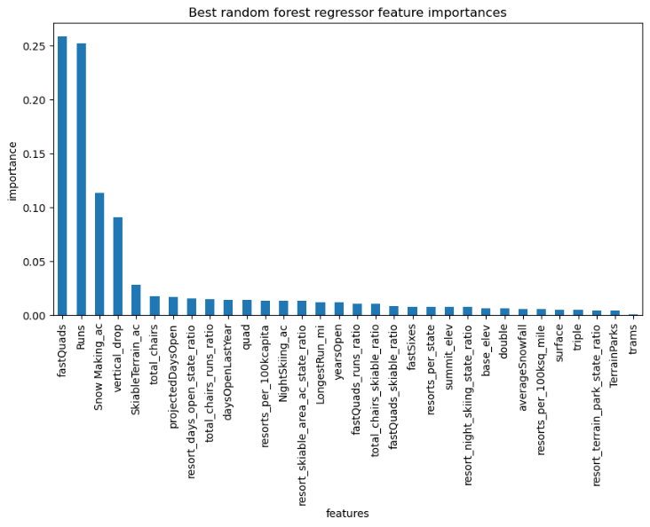
Key Value adds for customers:
# of fast quads
# of runs
Snow making machine area covered
Max vertical drop covering
Skiable terrain

Slide 6
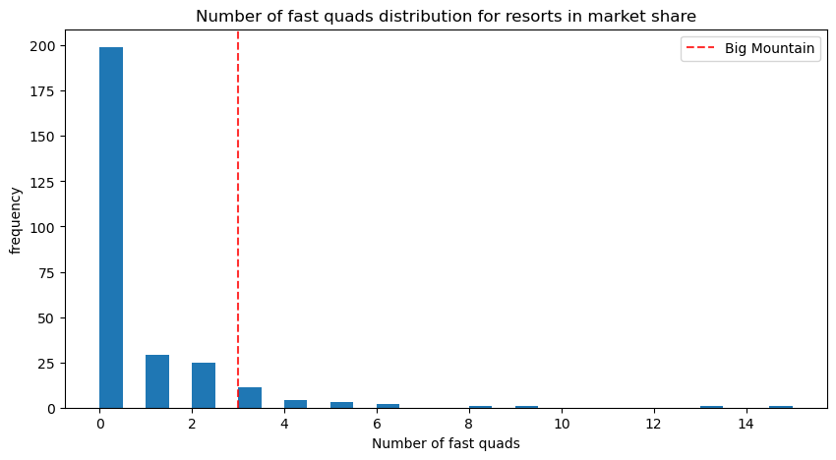
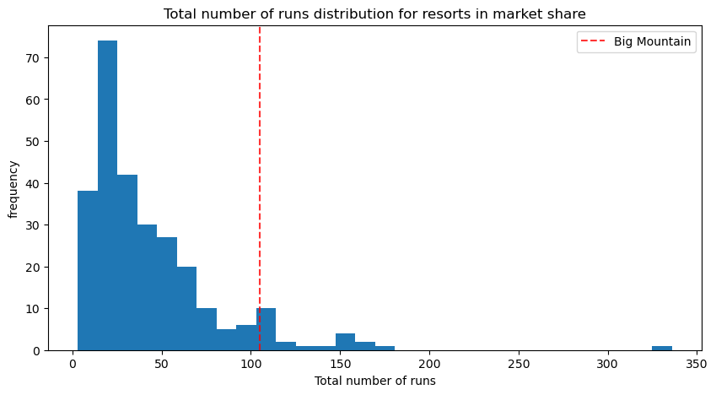
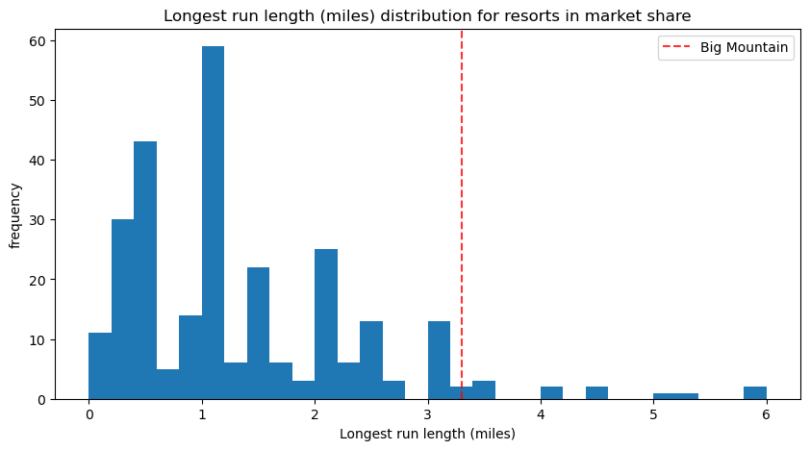
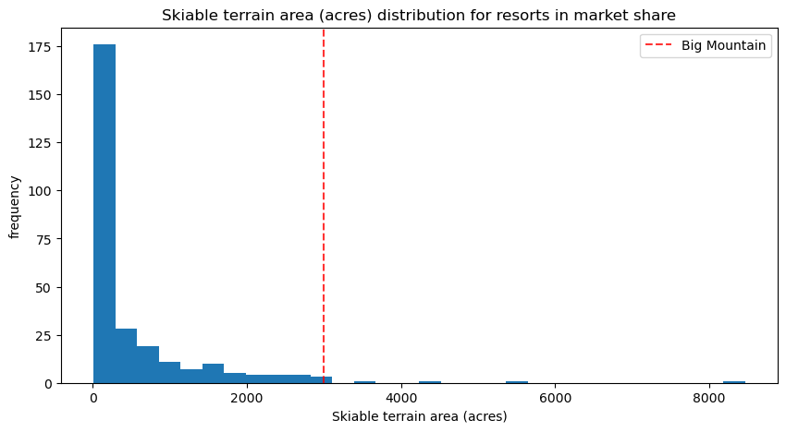
Where do we Stand for these offerings?

Slide 7
We can Justify a price increase with the features we provide, but which Scenario does the model favor?
1: -$1.81 TP
Decrease 10 runs offered
2: +1.99 TP
Increase vertical drop 150 ft
Additional chair
3: +1.99 TP
Increase vertical drop 150 ft
Additional chair
Additional 2 acres of snow making area
Increase the longest run by 0.2 miles
Additional 4 acres of snow making area
4: No change TP

Slide 8
Recommendation
My recommendation and model support scenario 2. The model supports a price increase of $1.99, resulting in a revenue increase of $3.47 million a year. Analysis supported a price increase up to $95. Working with executives and marketing, we can evaluate if such a price increase is viable. Customer analysis would be valuable to evaluate possible demand changes.

Slide 9
SUMMARY:
NEED TO INCREASE REVENUE
MODEL ANALYSIS & RECOMMENDATION
EXECUTION & NEXT STEPS
We have additional operating costs with a new run of $1.5 million a year
Can not decrease price or offering to customers
Model would recommend scenario 2 with an increase in revenue of $3.47 Million
Opportunity to increase price further given offerings
Opportunity to cut features less valued by customers
Talk with domain experts about the price increase
Customer analysis on price increase and feature changes

